Slide 1
Date: 18 November 2025

Slide 2




Weekly report: Team Gearbox, Brake, Coupling
Week number : 08
Date: 18/11/2025
Supervisor: Prof. Peter Quell
Group Members :Nehang Jitendra Joshi,Santo Mazumder,Md Razaul Karim Rahat
Presented by -Nehang Jitendra Joshi
18-11-2025
Gearbox, Brake, Coupling

Slide 3
List of Content
1.Calculation of the 1st stage of planetary gear and 2nd stage also Spur gear stage calculation updated
2.Steps of Pin for Elastomeric Bearing
3.Hss coupling calculation
18-11-2025
Gearbox, Brake, Coupling

Slide 4
Formulas for Planetary gear
z_Ring | z_Sun +( 2 x z_Planet)
z_Planet | z_Sun - z_Ring / 2
No. of Planets | 5 and 4
D_Sun | z_Sun x Module
D_Planets | (D_Ring /2) – (D_Sun/2)
D_Ring | z_Ring x Module
Gap | (D_Sun + D_Planets) * Pi / (No. of Planets) - D_Planets
Face Width | 10 x Module
Tooth Depth | 2.25 x Module
n_Ring | 0
n_Planet Carrier | 10.12 rpm
n_Sun | (1-i_1) x n_Planet Carrier
i_Sun,Planet | z_Planet / z_Sun
n_Planet | n_Sun / i_Sun,Planet
z = No. of Teeth
n = RPM
D = Pitch Circle Diameter
i = Gear Ratio
Reference: Lecture Notes by Prof. Peter Quell
18-11-2025
Gearbox, Brake, Coupling

Slide 5
Calculation for 1st stage of planetary
I-1 ratio | 5.2
D_Planets (mm) | 736
Module mm | 16
z_Sun | 34
z_Ring | 126
z_Planet | 46
No. of Planets | 5
(z_Sun + z_Ring)/No. of Planets | 32
Tooth Depth | 36
D_Sun (mm) | 544
D_Ring (mm) | 2016
Gap (mm) | 573.44
Face Width | 160
n_Ring (rpm) | 0
n_Planet Carrier (rpm) | 10.12
n_Sun (rpm) | 42.50
i_Sun,Planet | 1.35
n_Planet (rpm) | 31.48
Reference: Lecture Notes by Prof. Peter Quell and PSGdesign book
18-11-2025
Gearbox, Brake, Coupling

Slide 6
Calculation for 2nd stage of planetary
I-2 ratio | 4.7
D_Planets (mm) | 270
Module mm | 9
z_Sun | 40
z_Ring | 100
z_Planet | 30
No. of Planets | 4
(z_Sun + z_Ring)/No. of Planets | 35
Tooth Depth | 20.25
D_Sun (mm) | 360
D_Ring (mm) | 900
Gap (mm) | 137.25
Face Width | 90
n_Ring (rpm) | 0
n_Planet Carrier (rpm) | 78.4
n_Sun (rpm) | 516.56
i_Sun,Planet | 0.75
n_Planet (rpm) | 688.74
Reference: Lecture Notes by Prof. Peter Quell and PSGdesign book
18-11-2025
Gearbox, Brake, Coupling

Slide 7
Spur gear stage calculation
I-3 ratio | 4.8
Module mm | 9
Center distance mm | 585.8
No of teeth on pinion | 108
No.teeth on gear | 22
Width of the gear mm | 90
Hight factor mm | 1
Tooth depth mm | 20.25
Bottom clearance | 2.25
Dia of input shaft mm | 50
Dia of output shaft mm | 85
PCD of pinion | 972
PCD of gear | 198
Face width | 90
Input shaft rpm | 516.56
Output shaft rpm | 1200
Reference: Lecture Notes by Prof. Peter Quell and PSGdesign book
18-11-2025
Gearbox, Brake, Coupling

Slide 8
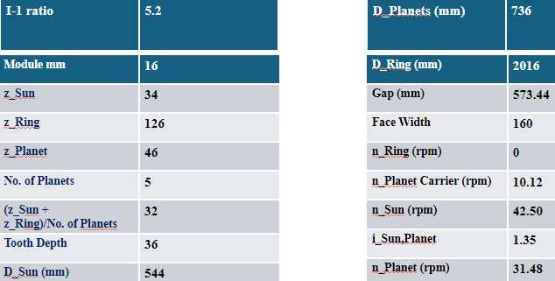
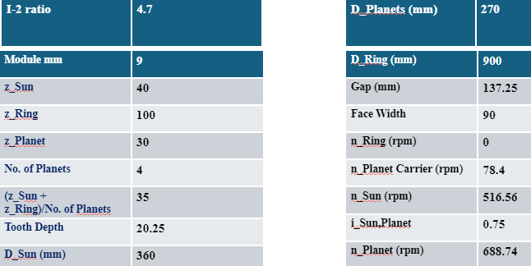
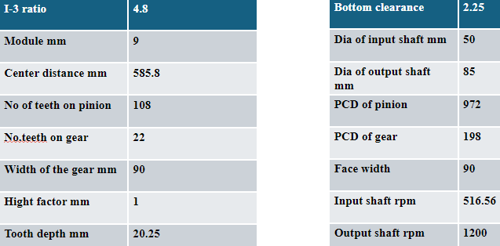
Overview gearbox data
18-11-2025
Gearbox, Brake, Coupling

Slide 9
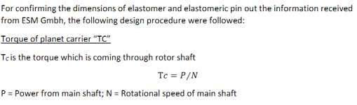
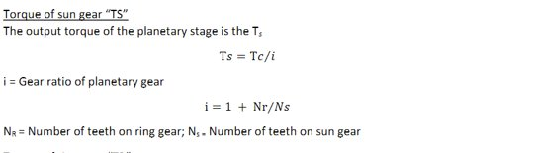
Steps of Pin for Elastomeric Bearing
18-11-2025
Gearbox, Brake, Coupling

Slide 10
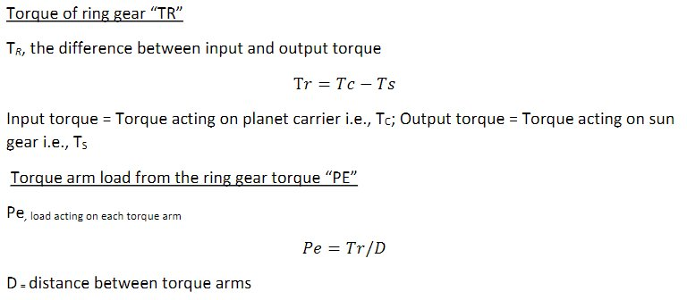
18-11-2025
Gearbox, Brake, Coupling

Slide 11
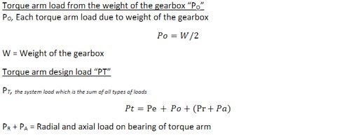
18-11-2025
Gearbox, Brake, Coupling

Slide 12
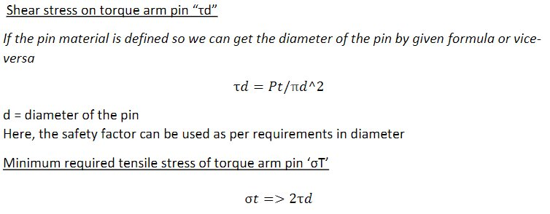
18-11-2025
Gearbox, Brake, Coupling

Slide 13
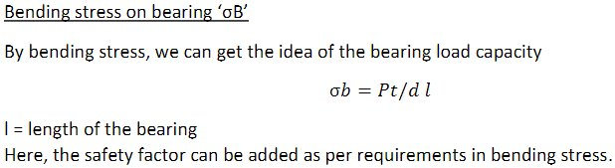
18-11-2025
Gearbox, Brake, Coupling

Slide 14
Torque and rotational speed calculation for Rotor and Generator
Rotor side
P rotor | 5.4 MW
nlss | 10.12 rpm
M rotor | 5,095 KN m
Generator side
nhss | 1200 rpm
Ratio i | 1200 /10.12 = 118.57
M generator | 41.9 KNm
18-11-2025
Gearbox, Brake, Coupling

Slide 15
Hss coupling calculation
Hss nominal torque Mn.gen - 41.9 KNm
Breakdown fator k-2.5 T allowable 100 n/mm^2
Md.hss=MNgen*k = 41.9 KNm * 2.5 = 104.75 KNm
Minimum diameter . Dhss= 3 (16*104.75*10^6 )N.mm/ 3.14 *100 N/mm^2
Dhss = 174.73 mm
18-11-2025
Gearbox, Brake, Coupling

Slide 16
Torque calculation for HSS coupling radex NANA
Nominal torque = P- 5.4 * 10^6 W Nhss= 1200 rpm
TN = p *60 / 2*3.14*1200
= 5.4 * 10^6 *60 / 2*3.14*1200 = 42971.835 Nm
18-11-2025
Gearbox, Brake, Coupling

Slide 17
Torque calculation for HSS coupling radex NANA
Medium or highspeed shaft calculation nN,mss = nNlss * I gearbox
= 10.12 rpm * 118.57 = 1199.93 rpm
Nominal low speed shaft calculation (MN,Lss)
MN,Lss = MN gen * I gearbox / n gearbox
= 41.9 KNm * 118.57 / 0.97 = 5121.74 KNm
Breakdown torque (Mbreakdown) = MN.lss * 2.5 = 12804.38 KNm
18-11-2025
Gearbox, Brake, Coupling

Slide 18
Bibliography
Gearbox
(1) Previous year Optimus projects(60E,92LE,Shakti 15-11-2025
(2) Roloff Matek Maschinenelemente 13-11-2025
(3) Lecture notes – Mechanical drive train by Prof.Peter Quell.14-11-2025
(4)Shigley's mechanical engineering design and PSG data book 14-11-2025
(5)thecatalystis.com website 15-11-2025
18-11-2025
Gearbox, Brake, Coupling

